Slide 1
Building a Digital Multimodal Transportation Infrastructure: Challenges and Solutions for the Northern Virginia Transportation Authority (NVTA) _{Introduction to GTFS2GMNS}
Roy Luo, Xuesong (Simon) Zhou at ASU
Presented at RTA Training Cycle 2024

Slide 2
Main Problem To Be Addressed.
Integrating Multimodal Transit Data from Various Agencies
Problem Statement: NVTA oversees multiple transit agencies, each with its own transportation data formats (e.g., GTFS, Cube files). Integrating this data into a unified multimodal network is a key challenge.
Problems to Solve:
How to efficiently consolidate diverse transit data from different agencies (WMATA, Fairfax Connector, VRE, etc.) into a cohesive system.
Ensuring consistency in data formats and definitions across different agencies (e.g., defining congestion levels or speeds from various sources like Inrix).

Slide 3
The Needs for Tool Development
Mapping and Visualizing the Multimodal Network
Problem Statement: Creating a digital, visual representation of the multimodal network is crucial for planning, real-time adjustments, and public communication.
Problems to Solve:
Developing a user-friendly visualization tool that can display current transit status, boarding patterns, and congestion points in real-time.
Generating corridor-based and zone-based transit maps that incorporate walking/driving links, transfer hubs, and access/egress links for accurate travel planning.

Slide 4
Ultimate Goal of GTFS2GMNS
Ensuring Data Consistency and Quality Across the Multimodal Network
Problem Statement: With multiple agencies providing data, ensuring data consistency (e.g., speeds, demand estimates, capacity) is crucial to creating an accurate model.
Problems to Solve:
Developing a standard data quality framework that ensures consistency in key metrics such as speed, capacity, and congestion levels.
Automating the validation process to detect and correct data inconsistencies in real-time.

Slide 5
Real-world Use Case
Optimizing Network Connections between Different Modes of Transport
Problem Statement: NVTA’s multimodal network includes metro, buses, commuter rail, and others. Efficient connectivity between these modes is essential to improve transit operations.
Problems to Solve:
Developing transfer links that minimize delays and optimize service between different transit modes.
Creating efficient transfer hubs, where switching between metro, bus, and rail is seamless, both in terms of infrastructure and scheduling.

Slide 6
Support Needs for Multimodal Planning
Addressing Congestion in Priority Corridors
Problem Statement: NVTA prioritizes key corridors (e.g., I395, I495, I66), but these corridors face significant congestion, particularly during peak hours.
Problems to Solve:
Using multimodal data to identify critical congestion points in these priority corridors and suggest real-time optimization strategies.
Aligning transit services to relieve congestion in these corridors by improving the public transit offering, using multimodal alternatives (e.g., encouraging park-and-ride services).

Slide 7
Supporting Multimodal Planning
Improving Last-Mile Connectivity
Problem Statement: Many passengers face challenges with last-mile connectivity to/from metro stations and bus stops.
Problems to Solve:
Designing access links that improve last-mile transit connections, including pedestrian and cycling infrastructure.
Incorporating ride-sharing and micro-transit options into the multimodal network to reduce reliance on personal vehicles for last-mile travel.

Slide 8
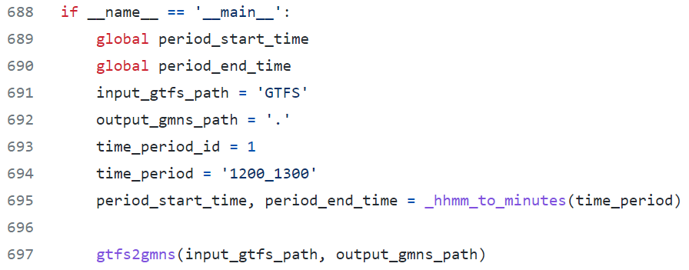
GTFS2GMNS Introduction
General Transit Feed Specification (GTFS) is a data specification that allows public transit agencies to publish their transit data.
GTFS2GMNS is an open-source Python code that enables users to conveniently construct any multi-modal transit network in GMNS format from GTFS. https://github.com/asu-trans-ai-lab/GTFS2GMNS
Main function of GTFS2GMNS
The path of data folder
Customized time period

Slide 9
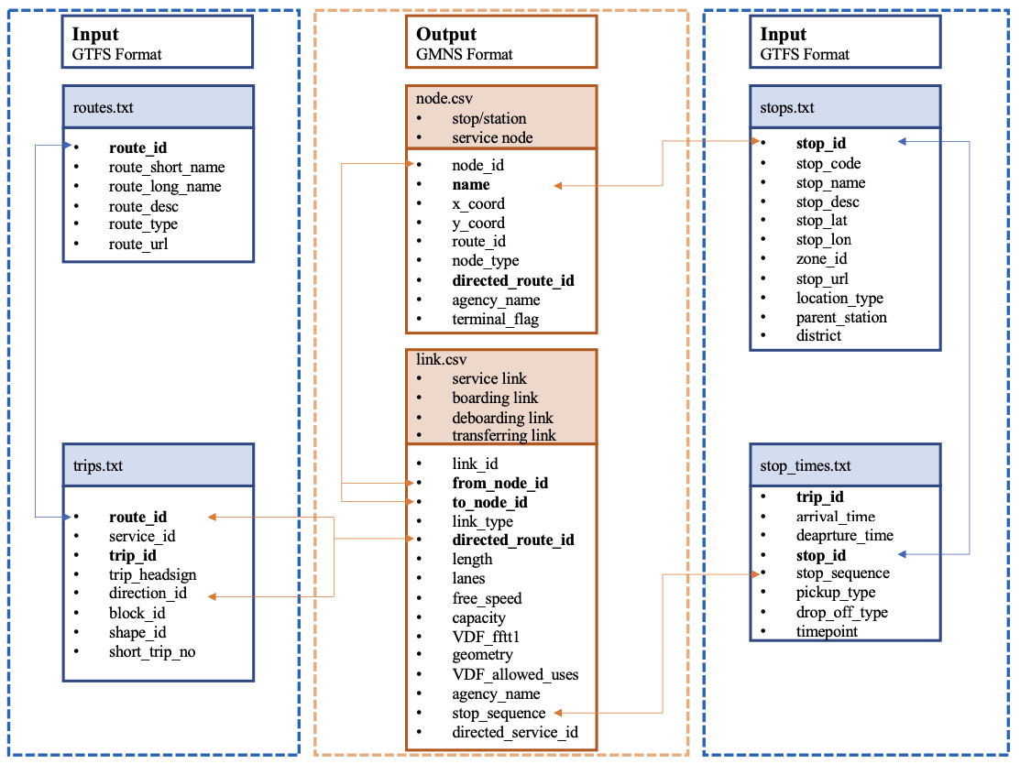
GTFS2GMNS Introduction
The data flow structure of converting GTFS to GMNS
Input
The input files of GTFS can be downloaded from the GTFS download website, including
routes.txt
trips.txt
stops.txt
stop_times.txt
The definition of the above files can be referenced here.
Output
Multi-modal transit network with GMNS format
node.csv
link.csv

Slide 10
Network definitions
link type code | link type name | definition
0 | Access/egress links | Links from activity zones to bus/metro or commuter rail stations
1 | Aboard/deboard links | Links connecting stations to stops of directed routes
2 | Service links | The links representing the planning of each route
3 | Transferring links | Transferring links between different stations/stops

Slide 11
Agencies
Washington Metropolitan Area Transit Authority (WMATA)
DC Circulator
DC Streetcar
Arlington Transit: ART,VA
Dash| Alexandria, VA
CUE Bus| Fairfax, VA
Fairfax Connector, VA
Potomac and Rappahannock Transportation Commission,VA
Loudoun County Transit, VA
Virginia Railway Express, VA
Amtrak
Transportation | Annapolis, MD
Transportation | Prince George's County,MD
Public Transportation | Calvert County, MD
Ride on | Montgomery, MD
TransIT | Frederick County, MD
Maryland Transit Administration
Carroll Transit System|Carroll County, MD
RTA of Central Maryland
VanGO | Charles County, MD
Remark 1: Other transit networks from additional agencies are incorporated from Cube files.
Notes:
We need to list both free-speed from the original model and reference speed from Inrix, and definition of LOS introduces potential inconsistency. Cleary define the critical speed, critical density for the congestion duration.
List from node id and to node id directly..
Show corridor/road id first and then show road order

Slide 12
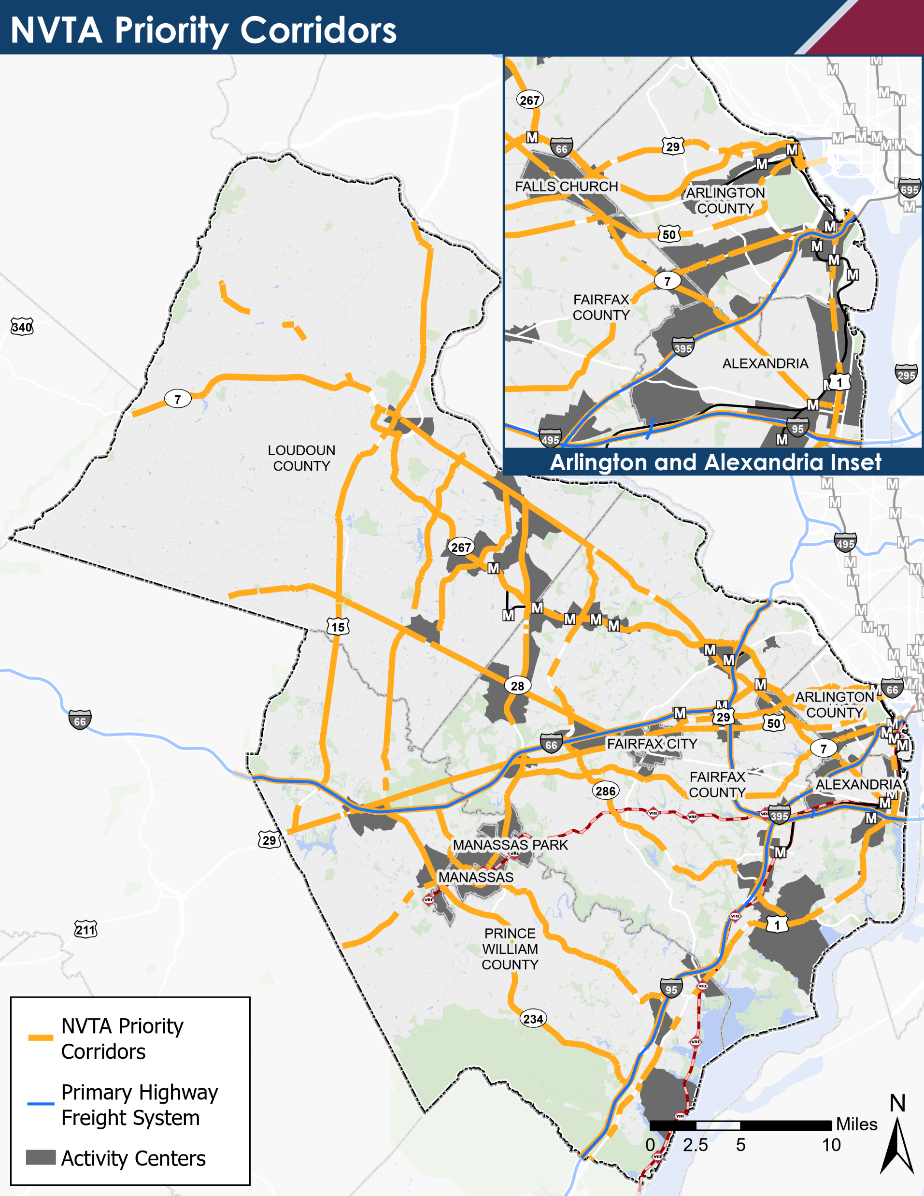
NVTA Priority Corridors
 | Priority Corridors/Segments
1 | I395
2 | I495
3 | I66
4 | I95
5 | RT7
6 | US1
7 | US15
8 | US29
9 | US50Inner
10 | US50Outer
11 | VA234
12 | VA244
13 | VA267
14 | VA28
15 | VA286
16 | VA294
17 | VA607
18 | VA620
19 | VA659
20 | VA9
Notes:
We need to list both free-speed from the original model and reference speed from Inrix, and definition of LOS introduces potential inconsistency. Cleary define the critical speed, critical density for the congestion duration.
List from node id and to node id directly..
Show corridor/road id first and then show road order

Slide 13
1) Link type and VDF_fftt
link type | link type name | definition | output file name (k is the sequence of agency) | VDF_fftt
1 | sta2sta_1r | physical link (same route only) | transit_agency_k_link.csv | 60*length/2
2 | sta2r | virtual link (entrance, exit link) | transit_agency_k_link.csv | entrance: min((1/2)*(1/freq)*60, 15) exit: 0
3 | r2r | service link (same route only) | transit_agency_k_link.csv | average travel time(from GTFS)
4 | sta2sta_2r | walking link across different routes | walking_link_transit_same_agency.csv | 60*length/2
5 | z2sta | walking/driving link | zone2stop_link.csv | 60*length/2 or 60*length/40
6 | s2s_2a | walking link | walking_link_transit_different_agency.csv | 60*length/2
Remark 1: The average walking speed is 2 miles per hour.
Remark 2: Average driving speed on freeway and arterial links involves map-matching from transit driving links to auto driving links, for each corridor.
Notes:
We need to list both free-speed from the original model and reference speed from Inrix, and definition of LOS introduces potential inconsistency. Cleary define the critical speed, critical density for the congestion duration.
List from node id and to node id directly..
Show corridor/road id first and then show road order

Slide 14
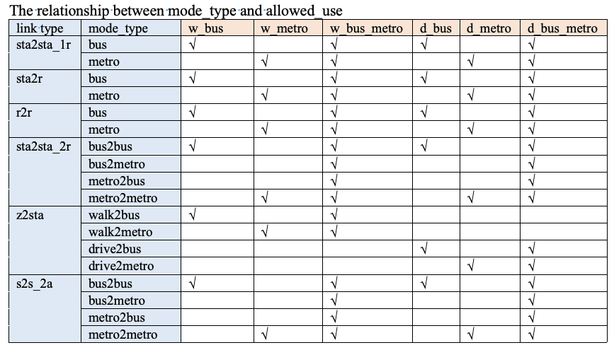
2) Mode type and Allowed use
Notes:
We need to list both free-speed from the original model and reference speed from Inrix, and definition of LOS introduces potential inconsistency. Cleary define the critical speed, critical density for the congestion duration.
List from node id and to node id directly..
Show corridor/road id first and then show road order

Slide 15
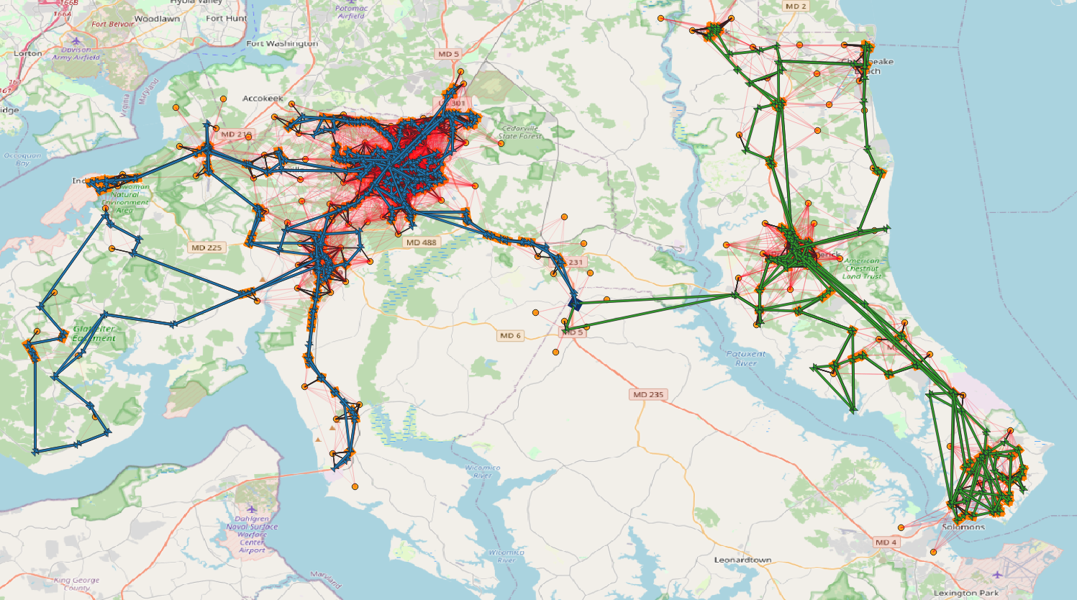
Network of Calvert and Charles
Notes:
We need to list both free-speed from the original model and reference speed from Inrix, and definition of LOS introduces potential inconsistency. Cleary define the critical speed, critical density for the congestion duration.
List from node id and to node id directly..
Show corridor/road id first and then show road order

Slide 16
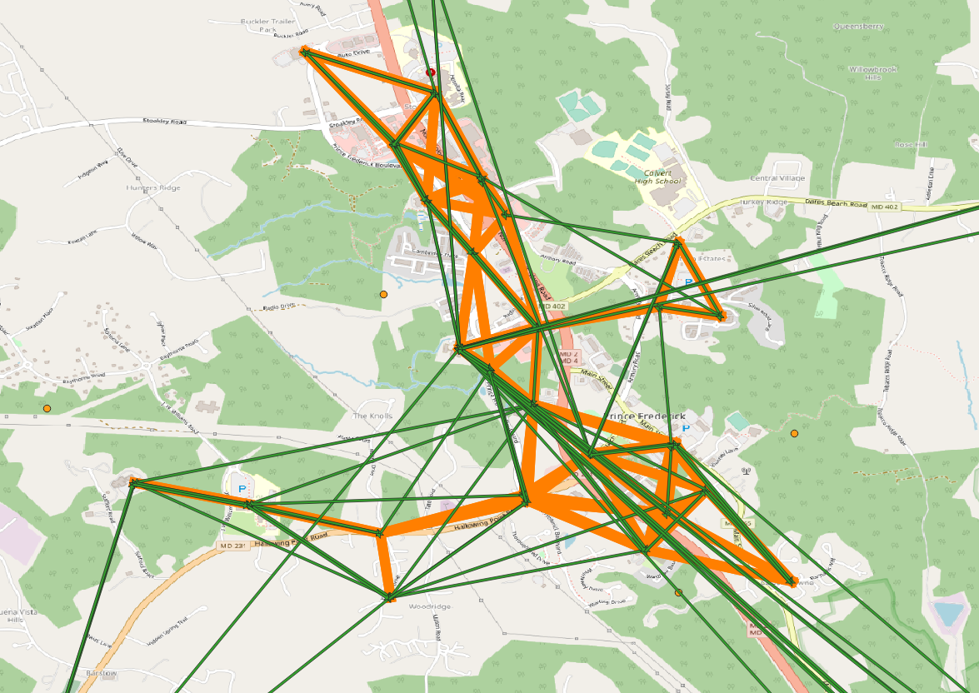
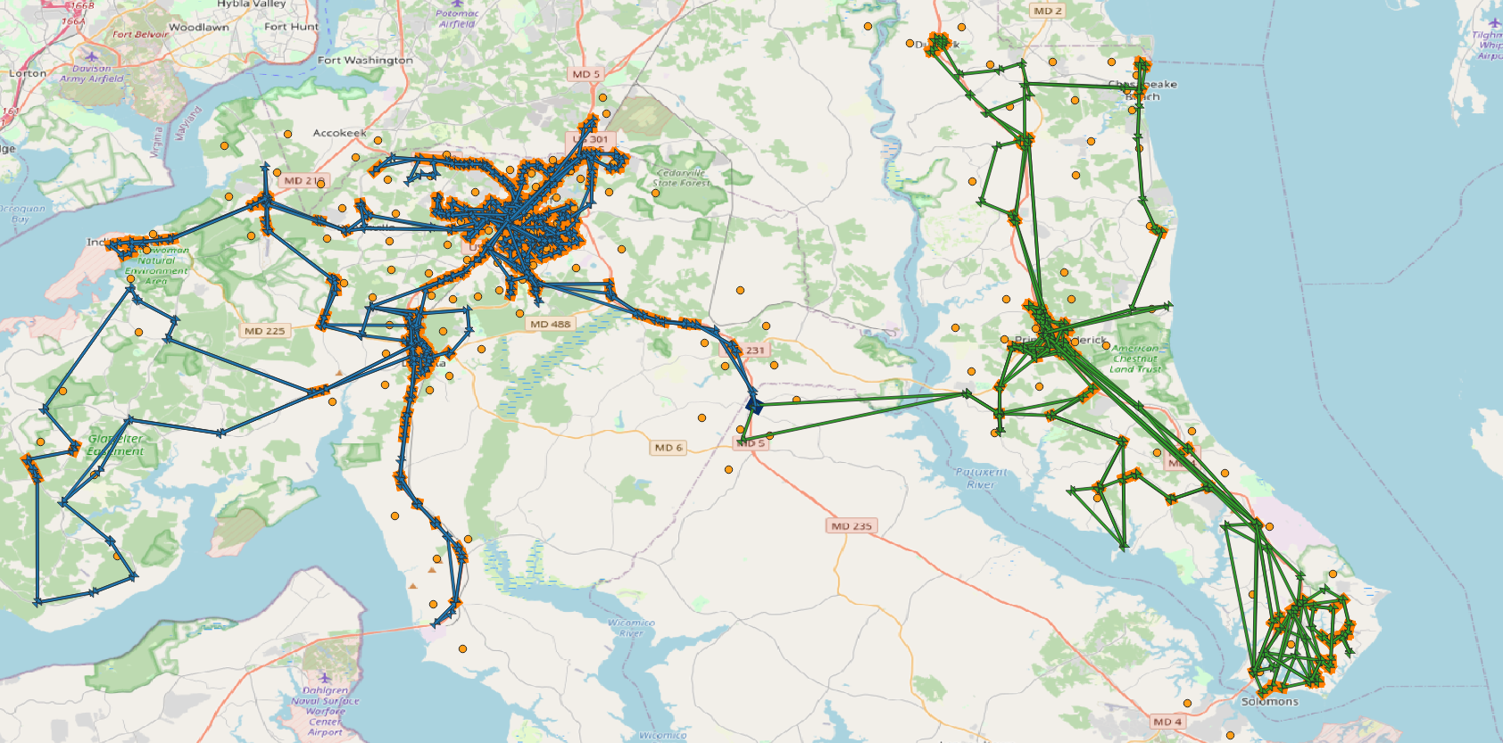
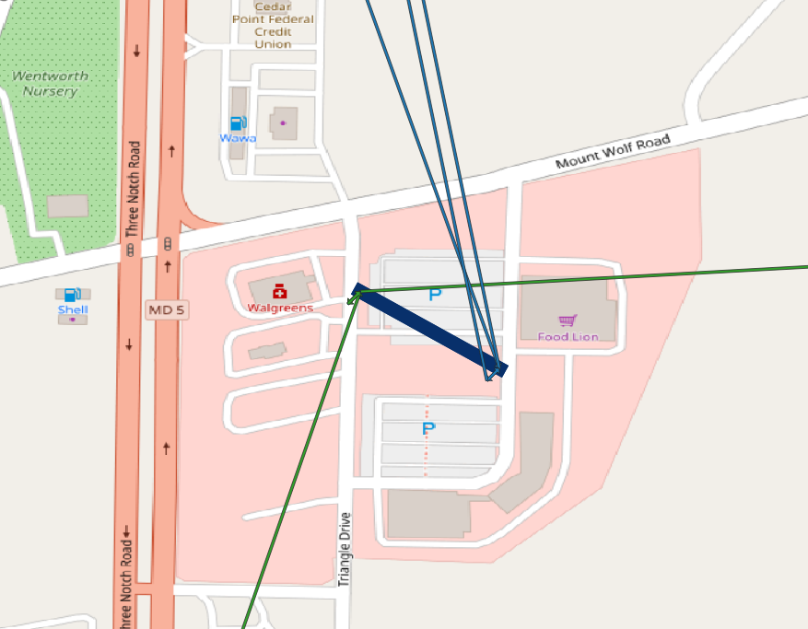
3) Network—transfer links
Notes:
We need to list both free-speed from the original model and reference speed from Inrix, and definition of LOS introduces potential inconsistency. Cleary define the critical speed, critical density for the congestion duration.
List from node id and to node id directly..
Show corridor/road id first and then show road order

Slide 17
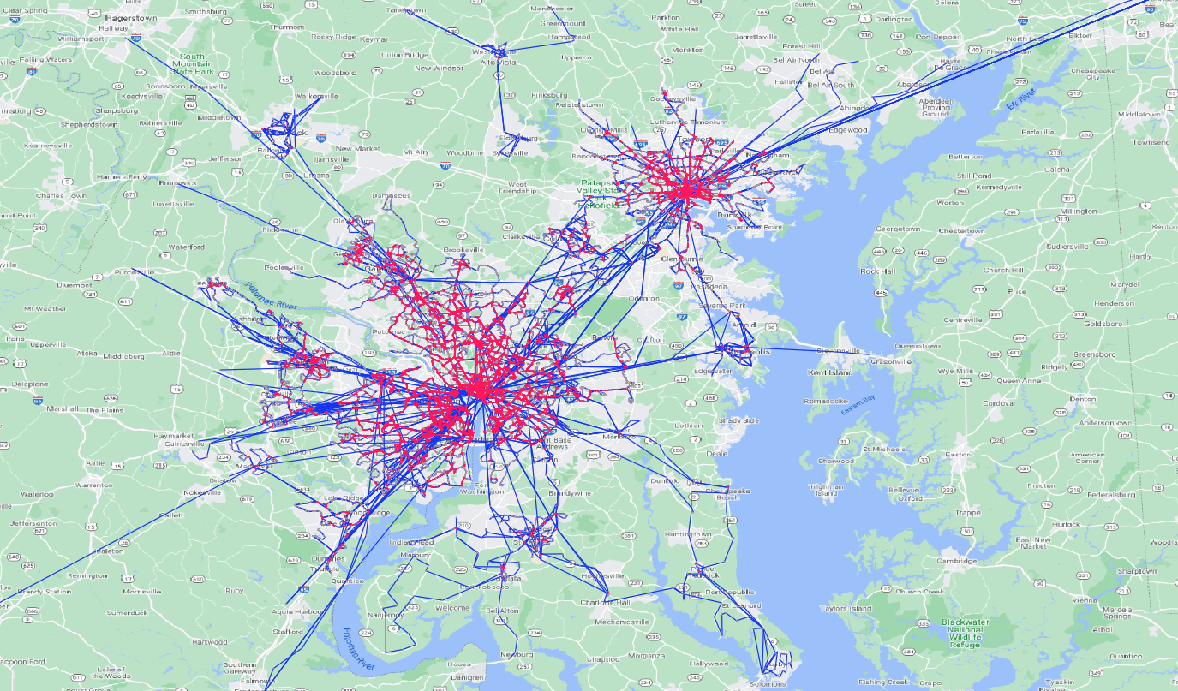
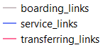
Networks of 20 agencies
Notes:
We need to list both free-speed from the original model and reference speed from Inrix, and definition of LOS introduces potential inconsistency. Cleary define the critical speed, critical density for the congestion duration.
List from node id and to node id directly..
Show corridor/road id first and then show road order

Slide 18
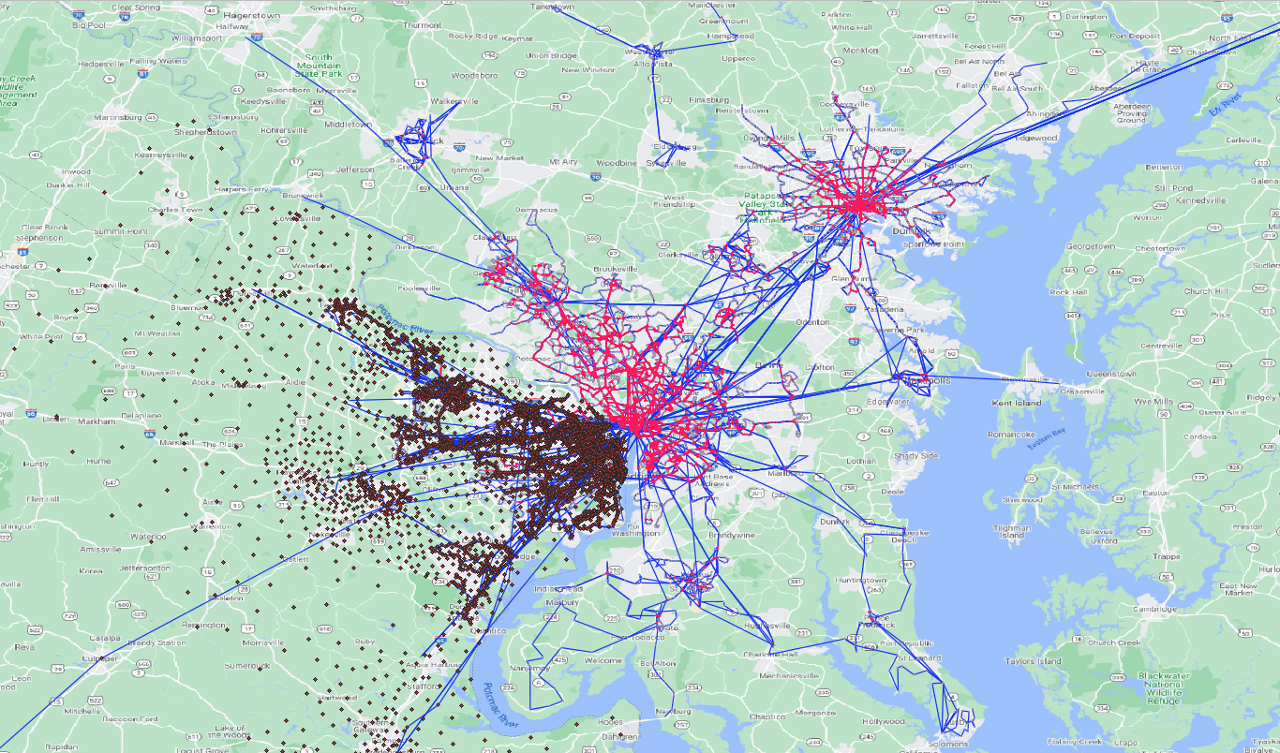
4) Zones and nodes in Northern Virginia
Notes:
We need to list both free-speed from the original model and reference speed from Inrix, and definition of LOS introduces potential inconsistency. Cleary define the critical speed, critical density for the congestion duration.
List from node id and to node id directly..
Show corridor/road id first and then show road order

Slide 19
5) Demands
Agent_types | Defintions | Peak | AM | PM | Off-peak
d_bus_metro | KNR_BUS_MR, PNR_BUS_MR | 20,611.38 | 10,305.69 | 10,305.69 | 2,462.66
d_bus_only | KBR_BUS,PNR_BUS | 30,561.52 | 15,280.76 | 15,280.76 | 8,434.90
d_metro_only | KNR_MR, PNR_MR | 130,529.98 | 65,264.99 | 65,264.99 | 47,169.55
d_rail_only | PNR_KNR_CR | 29,584.95 | 14,792.47 | 14,792.47 | 2,860.49
w_bus_metro | WK_BUS_MR | 100,295.84 | 50,147.92 | 50,147.92 | 22,050.59
w_bus_only | WK_BUS | 119,354.24 | 59,677.12 | 59,677.12 | 194,398.75
w_metro_only | WK_MR | 189,905.32 | 94,952.66 | 94,952.66 | 99,633.29
w_rail_only | WK_CR | 8,777.73 | 4,388.87 | 4,388.87 | 2,280.47
 | Total | 629,620.96 | 314,810.48 | 314,810.48 | 379,290.70
Notes:
We need to list both free-speed from the original model and reference speed from Inrix, and definition of LOS introduces potential inconsistency. Cleary define the critical speed, critical density for the congestion duration.
List from node id and to node id directly..
Show corridor/road id first and then show road order

Slide 20
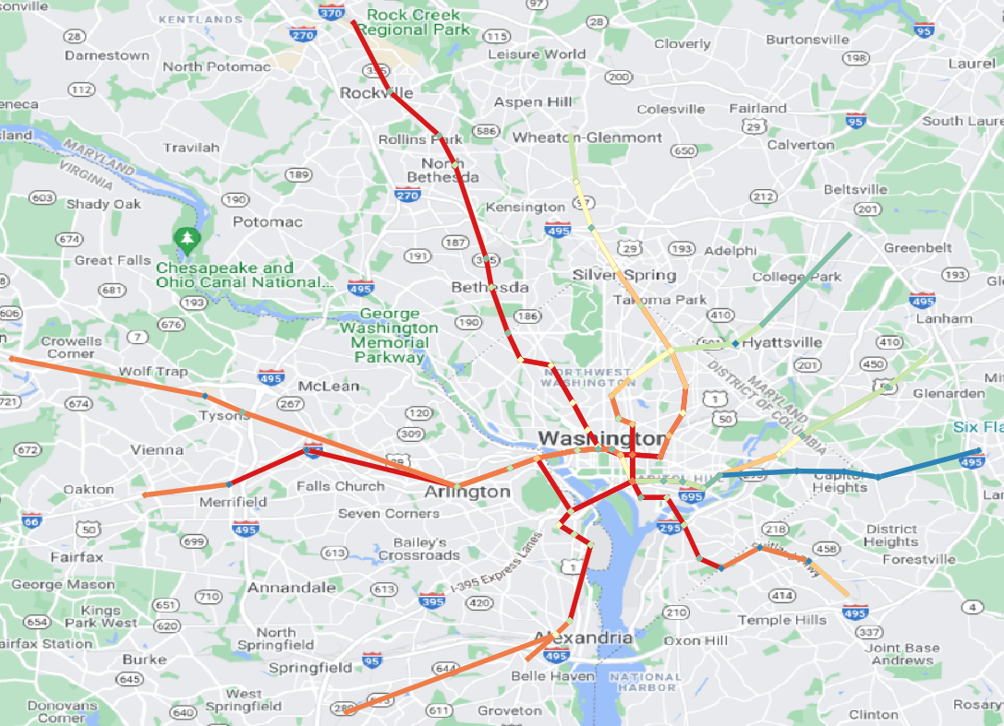
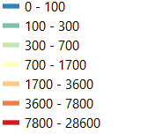
Transit assignment results (METRO, AM)
Notes:
We need to list both free-speed from the original model and reference speed from Inrix, and definition of LOS introduces potential inconsistency. Cleary define the critical speed, critical density for the congestion duration.
List from node id and to node id directly..
Show corridor/road id first and then show road order

Slide 21
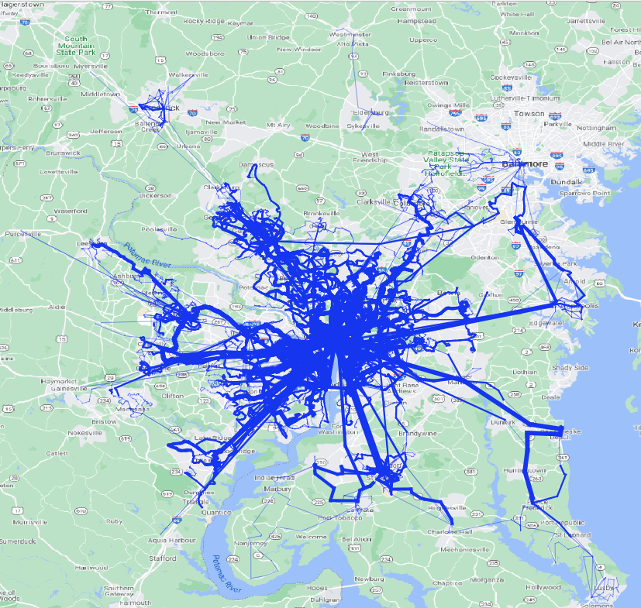
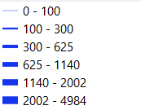
Transit assignment results (BUS, AM)
Notes:
We need to list both free-speed from the original model and reference speed from Inrix, and definition of LOS introduces potential inconsistency. Cleary define the critical speed, critical density for the congestion duration.
List from node id and to node id directly..
Show corridor/road id first and then show road order

Slide 22
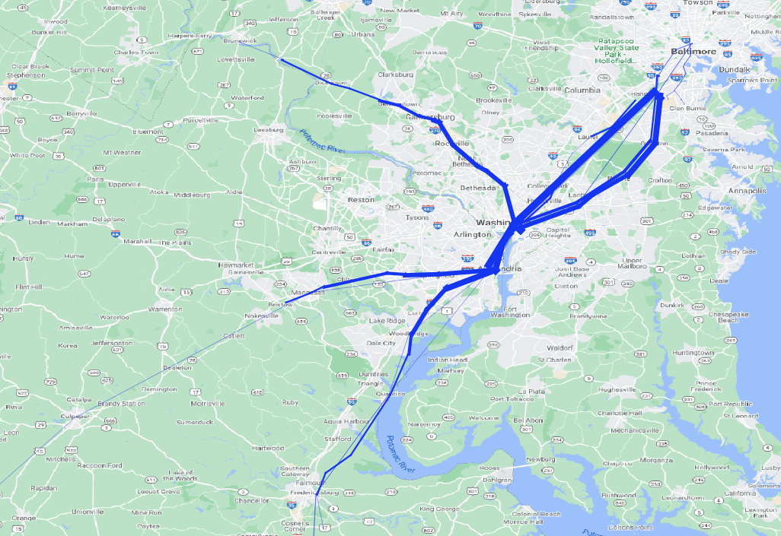
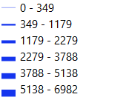
Transit assignment results (CR+TRAM, AM)
Notes:
We need to list both free-speed from the original model and reference speed from Inrix, and definition of LOS introduces potential inconsistency. Cleary define the critical speed, critical density for the congestion duration.
List from node id and to node id directly..
Show corridor/road id first and then show road order

Slide 23
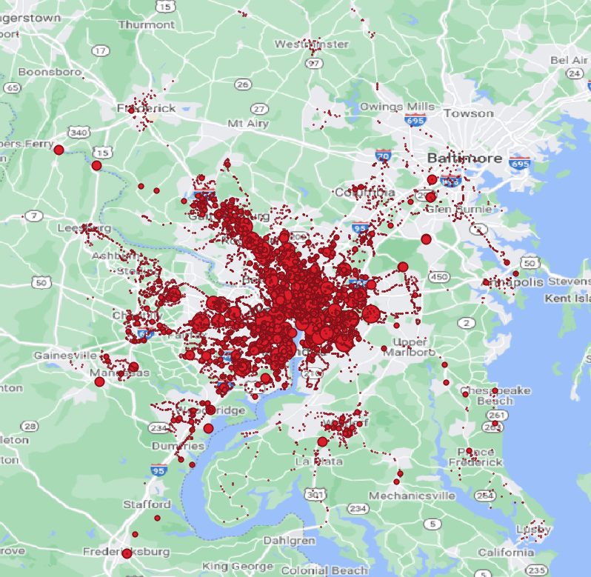
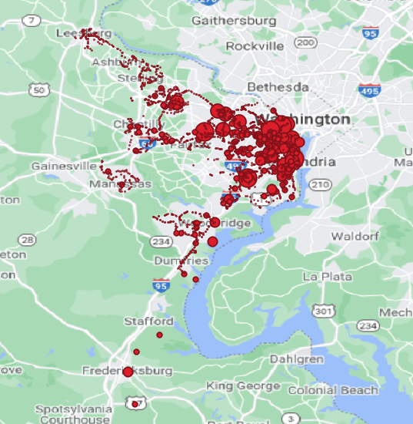
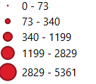
Distribution of boarding
Boardings in the Model Domain
Boardings in Northern Virginia
Notes:
We need to list both free-speed from the original model and reference speed from Inrix, and definition of LOS introduces potential inconsistency. Cleary define the critical speed, critical density for the congestion duration.
List from node id and to node id directly..
Show corridor/road id first and then show road order

Slide 24
Daily Boardings by Modes in the Model Domain
 | Observed Boardings | Estimated Boardings (CUBE) | Estimated Boardings (DTALite) | Percentage Deviation (CUBE) | Percentage Deviation (DTALite)
Bus (Metrobus + Local bus) | 582,049 | 610,721 | 615,554.79 | 5% | 6%
Metrorail | 626,422 | 641,788 | 613,785.57 | 2% | 2%
Commuter rail (VRE+MARC) | 39,041 | 43,329 | 43,657 | 11% | 12%
Notes:
We need to list both free-speed from the original model and reference speed from Inrix, and definition of LOS introduces potential inconsistency. Cleary define the critical speed, critical density for the congestion duration.
List from node id and to node id directly..
Show corridor/road id first and then show road order

Slide 25
Daily Boardings by Modes in in Northern Virginia
 | Observed Boardings | Estimated Boardings (CUBE) | Estimated Boardings (DTALite) | Percentage Deviation (CUBE) | Percentage Deviation (DTALite)
Bus (Metrobus + Local bus) | 136,507 | 161,693 | 155,090.56 | 18% | 14%
Metrorail | 144,521 | 139,801 | 155,432.49 | 3% | 8%
Commuter rail (VRE+MARC) | 11,823 | 12,277 | 10,187 | 4% | 14%
Notes:
We need to list both free-speed from the original model and reference speed from Inrix, and definition of LOS introduces potential inconsistency. Cleary define the critical speed, critical density for the congestion duration.
List from node id and to node id directly..
Show corridor/road id first and then show road order

